Slide 1

Machine Learning
ICT-4261
By-
Dr. Jesmin Akhter
Professor
Institute of Information Technology
Jahangirnagar University

Slide 2
Contents
The course will mainly cover the following topics:
A Gentle Introduction to Machine Learning
Linear Regression
Logistic Regression
Naive Bayes
Support Vector Machines
Decision Trees and Ensemble Learning
Clustering Fundamentals
Hierarchical Clustering
Neural Networks and Deep Learning
Unsupervised Learning……
Notes:
More Supervised - Adaboost Gradient boosting Xgboost

Slide 3
Outline
A Gentle Introduction to Machine Learning
Unsupervised learning
Reinforcement learning
Regression

Slide 4
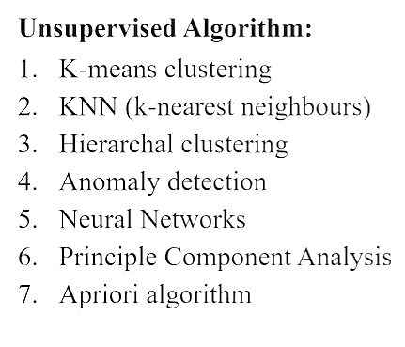
Types of Unsupervised Learning
Unsupervised learning can be broken down into three main tasks:
Clustering
Association rules
Dimensionality reduction.

Slide 5
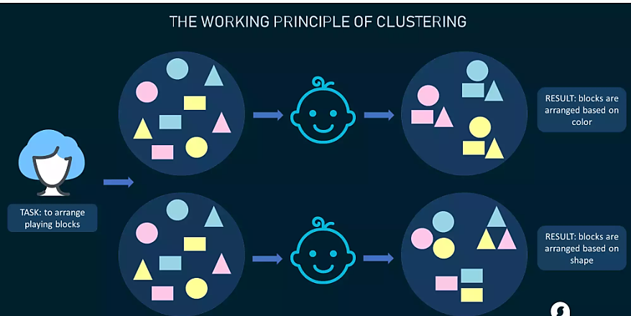
Types of Unsupervised Learning
Clustering Algorithms
Clustering algorithms only interpret the input data and find natural groups or clusters in feature space
Clustering is a popular type of unsupervised learning approach. You can even break it down further into different types of clustering; for example:
Exlcusive clustering: or “hard” clustering
It is the kind of grouping in which one piece of data can belong only to one cluster.
Overlapping clustering:
A soft cluster in which a single data point may belong to multiple clusters with varying degrees of membership.

Slide 6
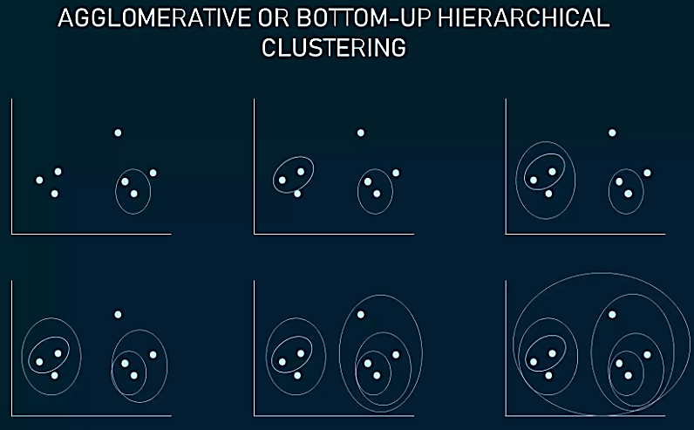
Types of Unsupervised Learning
Clustering Algorithms
Hierarchical Clustering:
Hierarchical clustering develops a hierarchy of clusters by merging or splitting them depending on their similarity. Here, two close cluster are going to be in the same cluster.
In case you start with all data items attached to the same cluster and then perform splits until each data item is set as a separate cluster, the approach will be called top-down or divisive hierarchical clustering.
Two clusters that are closest to one another are then merged into a single cluster. The merging goes on iteratively till there's only one cluster left at the top. Such an approach is known as bottom-up or agglomerative.
The example shows how seven different clusters (data points) are merged step by step based on distance until they all create one large cluster.

Slide 7
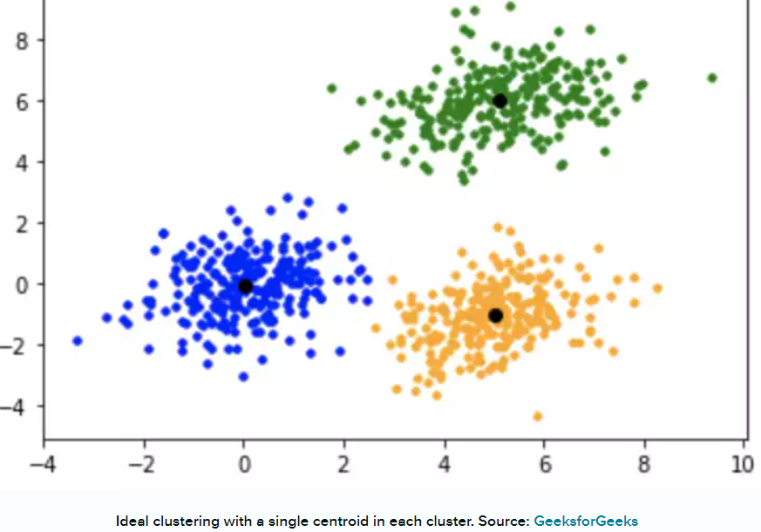
Types of Unsupervised Learning
Clustering Algorithms
K-Means Clustering
In K-means clustering, data is grouped in terms of characteristics and similarities.
K is a letter that represents the number of clusters. For example, if K=5, then the number of desired clusters is 5. If K=10, then the number of desired clusters is 10.
It puts the data points into the predefined number of clusters K.
Each data item then gets assigned to the nearest cluster center, called centroids (black dots in the picture). The latter act as data accumulation areas.
The procedure of clustering may be repeated several times until the clusters are well-defined.
Notes:
In this algorithm, data is divided into a specific number of groups or clusters. It is achieved by minimizing the total squared distances between the data points and the centers of each cluster.

Slide 8
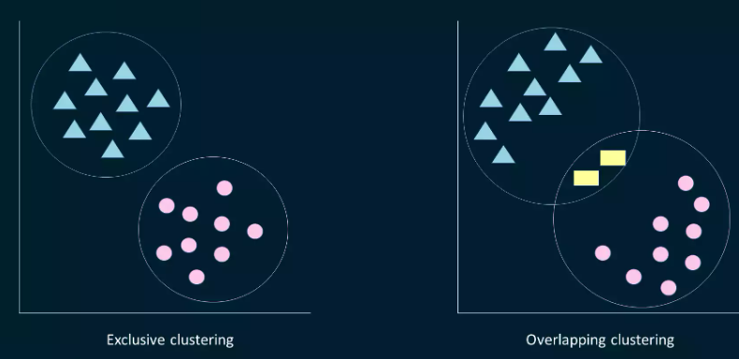
Types of Unsupervised Learning
Clustering Algorithms
Fuzzy K-means
It is an extension of the K-means algorithm used to perform overlapping clustering. Unlike the K-means algorithm, fuzzy K-means implies that data points can belong to more than one cluster with a certain level of closeness towards each.
The closeness is measured by the distance from a data point to the centroid of the cluster. So, sometimes there may be an overlap between different clusters.

Slide 9
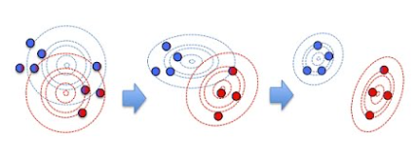
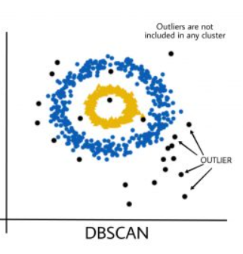
Types of Unsupervised Learning
Clustering Algorithms
Gaussian Mixture Models (GMMs) is an algorithm used in probabilistic clustering.
Models assume that there is a certain number of Gaussian distributions, each representing a separate cluster.
The algorithm is basically utilized to decide which cluster a particular data point belongs to.
DBSCAN (Density-Based Spatial Clustering of Applications with Noise): DBSCAN groups data points based on their density, identifying clusters of high-density regions and classifying outliers as noise.

Slide 10
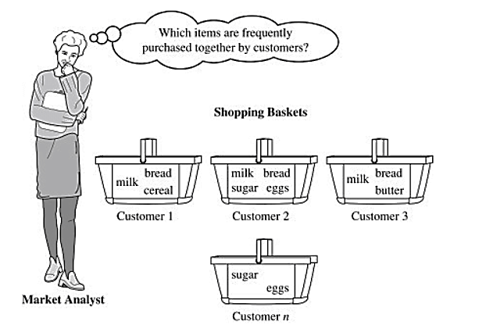
Types of Unsupervised Learning
Association Rule Mining
Association rule mining focuses on discovering interesting relationships or patterns between variables in the large database. It determines the set of items that occurs together in the dataset. Association rule makes marketing strategy more effective. Such as people who buy X (suppose a bread) also tend purchase Y (Butter/Jam) item. The widely used algorithm for association rule mining is the Apriori algorithm.
A real-life example of this is market basket analysis, where retailers analyze customer purchase data to identify relationships between products frequently bought together. For instance, this analysis might reveal that customers who purchase diapers also tend to buy baby wipes

Slide 11
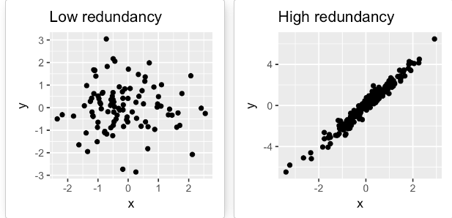
Types of Unsupervised Learning
Dimensionality Reduction Algorithms Dimensionality reduction techniques are used to reduce the number of input variables or features while retaining meaningful information. Some popular dimensionality reduction algorithms include:
Principal Component Analysis (PCA): PCA transforms the original features into a lower-dimensional space while preserving the maximum amount of information.
The PCA method is particularly useful when the variables within the data set are highly correlated. Correlation indicates that there is redundancy in the data. Due to this redundancy, PCA can be used to reduce the original variables into a smaller number of new variables ( principal components) explaining most of the variance in the original variables.

Slide 12
What is the difference between supervised and unsupervised learning?
Supervised learning requires labeled data with input features and corresponding output labels, while unsupervised learning aims to discover patterns or structures in unlabeled data without predefined output labels.

Slide 13

Reinforcement machine learning
Reinforcement Learning(RL) enables an agent to learn in an interactive environment by trial and error using feedback from its own actions and experiences.
Here, agents are self-trained on reward and punishment mechanisms.
It can take actions and interact with it.
Reinforcement machine learning algorithm isn’t trained using sample data.
A sequence of successful outcomes will be reinforced to develop the best recommendation or policy for a given problem.
Basic Diagram of Reinforcement Learning
Notes:
This model learns as it goes by using trial and error.

Slide 14
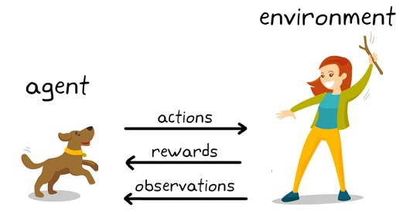
Reinforcement machine learning
Through a series of Trial and Error methods, an agent keeps learning continuously in an interactive environment from its own actions and experiences.
The only goal of it is to find a suitable action model which would increase the total cumulative reward of the agent.
It learns via interaction and feedback.
You can see a dog and a master. Let’s imagine you are training your dog to get the stick. Each time the dog gets a stick successfully, you offered him a feast (a bone ).
Eventually, the dog understands the pattern, that whenever the master throws a stick, it should get it as early as it can to gain a reward (a bone) from a master in a lesser time.
Reinforcement Learning Example

Slide 15
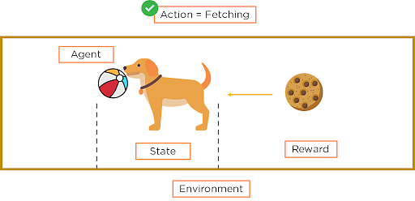
Important Terms in Reinforcement Learning
Agent: Agent is the model that is being trained via reinforcement learning. It is the sole decision-maker and learner
Environment: a physical world where an agent learns and decides the actions to be performed
Action: All possible steps that can be taken by the model/agent
State: The current position/ condition returned by the model/the current situation of the agent in the environment
Reward: To help the model move in the right direction, it is rewarded/points are given to it to appraise some action. It’s usually a scalar value and nothing but feedback from the environment
Policy: Policy determines how an agent will behave at any time. It acts as a mapping between Action and present State. The agent prepares strategy(decision-making) to map situations to actions.
Value — Future reward that an agent would receive by taking an action in a particular state

Slide 16
Outline
Linear Regression
Linear models
A bidimensional example
Hypothesis function for Linear Regression
Cost function

Slide 17
Regression
Linear regression is a type of supervised machine learning algorithm that computes the linear relationship between a dependent variable and one or more independent features.
When the number of the independent feature, is 1 then it is known as Univariate Linear regression, and in the case of more than one feature, it is known as multivariate linear regression.
It predicts the continuous output variables based on the independent input variable like the prediction of house prices based on different parameters like house age, distance from the main road, location, area, size etc.

Slide 18
Linear Regression
The goal of the algorithm is to find the best linear equation that can predict the value of the dependent variable based on the independent variables.
The equation provides a straight line that represents the relationship between the dependent and independent variables.
The slope of the line indicates how much the dependent variable changes for a unit change in the independent variable(s).
Linear regression is used in many different fields, including finance, economics, and psychology, to understand and predict the behavior of a particular variable.
For example, in finance, linear regression might be used to understand the relationship between a company’s stock price and its earnings or to predict the future value of a currency based on its past performance.

Slide 19
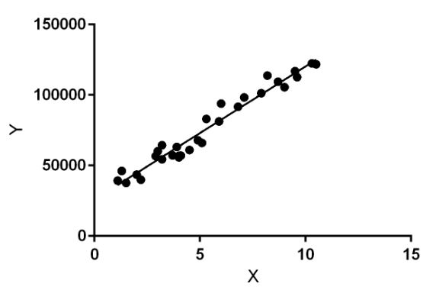
Linear Regression
Y is a dependent or target variable and X is an independent variable also known as the predictor of Y.
There are many types of functions or modules that can be used for regression.
A linear function is the simplest type of function.
X may be a single feature or multiple features representing the problem.
Linear regression performs the task to predict a dependent variable value (y) based on a given independent variable (x)). Hence, the name is Linear Regression.
In the figure, X (input) is the work experience and Y (output) is the salary of a person.

Slide 20
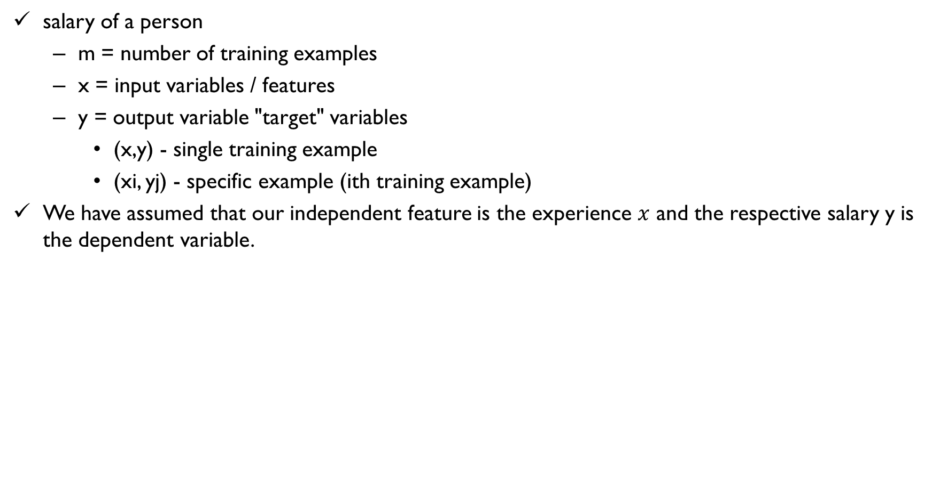
Hypothesis function for Linear Regression
salary of a person
m = number of training examples
x = input variables / features
y = output variable "target" variables
(x,y) - single training example
(xi, yj) - specific example (ith training example)
We have assumed that our independent feature is the experience $x$ and the respective salary y is the dependent variable.
x(Work experience in years ) | y(salary)
2 | 3000
3 | 4000
4 | 5000
5 | 6000
10 | 11000
12 | 13000

Slide 21
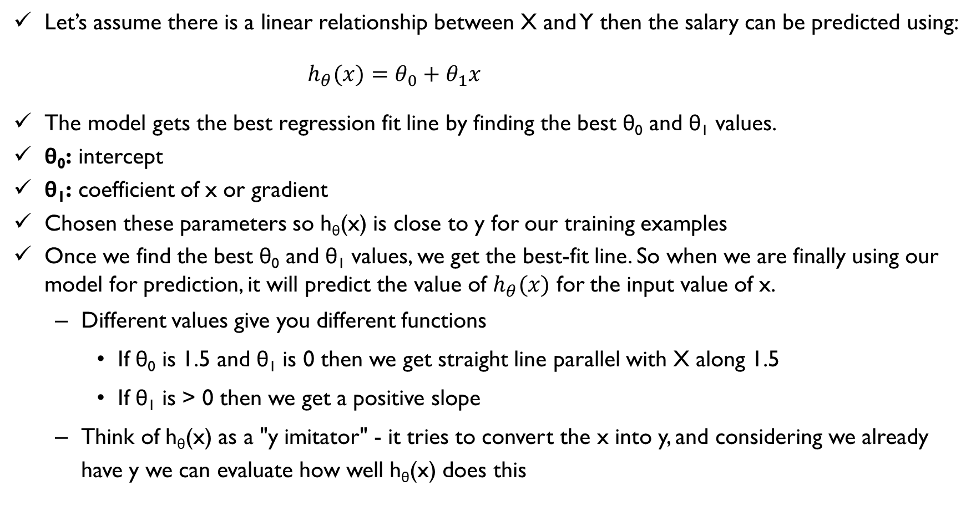
Hypothesis function for Linear Regression
Let’s assume there is a linear relationship between X and Y then the salary can be predicted using:
$h_{θ}(x)=θ_{0}+θ_{1}x$
The model gets the best regression fit line by finding the best θ₀ and θ₁ values.
θ₀: intercept
θ₁: coefficient of x or gradient
Chosen these parameters so h_{θ}(x) is close to y for our training examples
Once we find the best θ₀ and θ₁ values, we get the best-fit line. So when we are finally using our model for prediction, it will predict the value of $h_{θ}(x)$ for the input value of x.
Different values give you different functions
If θ₀ is 1.5 and θ₁ is 0 then we get straight line parallel with X along 1.5
If θ₁ is > 0 then we get a positive slope
Think of h_{θ}(x) as a "y imitator" - it tries to convert the x into y, and considering we already have y we can evaluate how well h_{θ}(x) does this

Slide 22
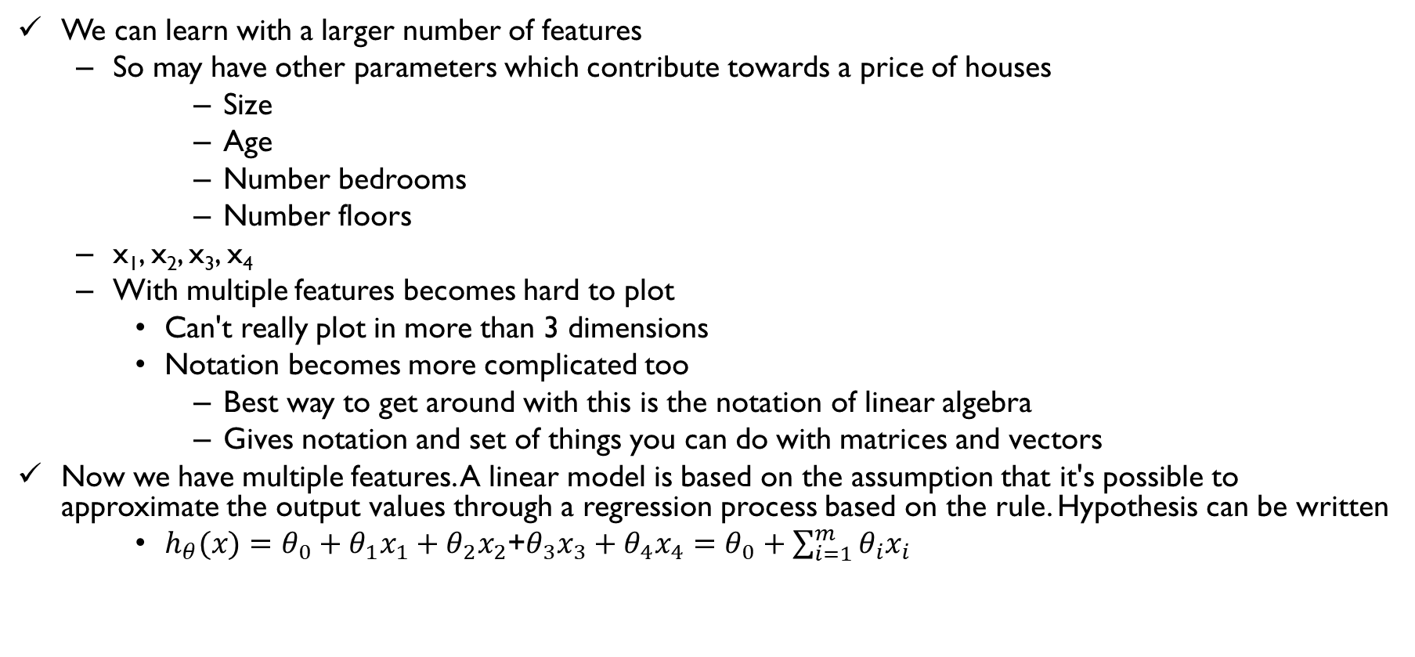
Linear models
We can learn with a larger number of features
So may have other parameters which contribute towards a price of houses
Size
Age
Number bedrooms
Number floors
x₁, x₂, x₃, x₄
With multiple features becomes hard to plot
Can't really plot in more than 3 dimensions
Notation becomes more complicated too
Best way to get around with this is the notation of linear algebra
Gives notation and set of things you can do with matrices and vectors
Now we have multiple features. A linear model is based on the assumption that it's possible to approximate the output values through a regression process based on the rule. Hypothesis can be written
$h_{θ}(x)=θ_{0}+θ_{1}x_{1}+θ_{2}x_{2}$+$θ_{3}x_{3}+θ_{4}x_{4}=θ_{0}+\sum_{i=1}^{m}{θ_{i}x_{i}}$

Slide 23
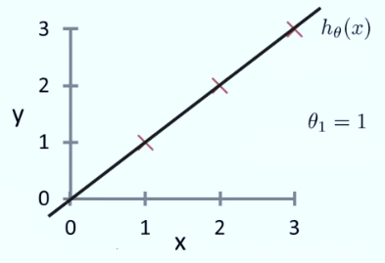
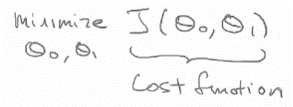
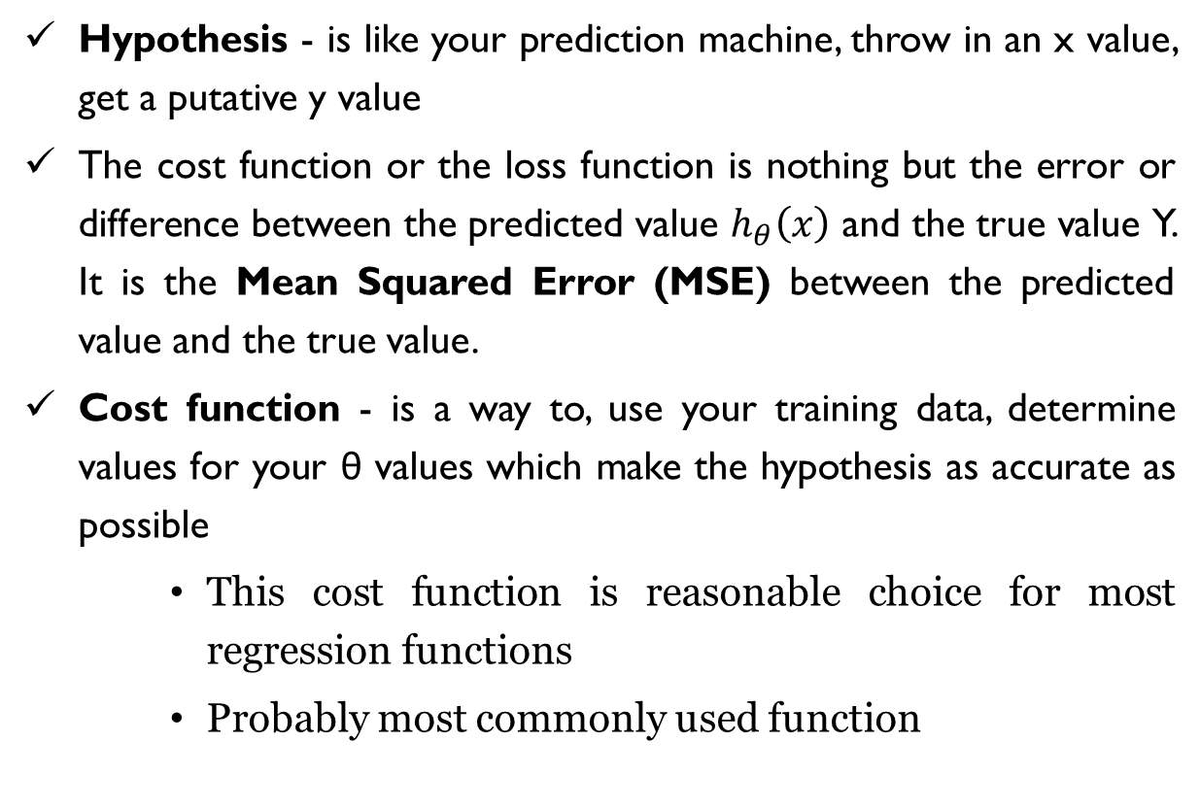
Implementation: cost function(Cont.)
Hypothesis - is like your prediction machine, throw in an x value, get a putative y value
The cost function or the loss function is nothing but the error or difference between the predicted value $h_{θ}\left(x\right)$ and the true value Y. It is the Mean Squared Error (MSE) between the predicted value and the true value.
Cost function - is a way to, use your training data, determine values for your θ values which make the hypothesis as accurate as possible
This cost function is reasonable choice for most regression functions
Probably most commonly used function

Slide 24
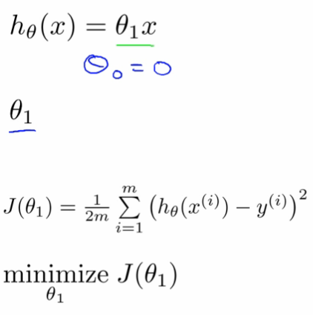
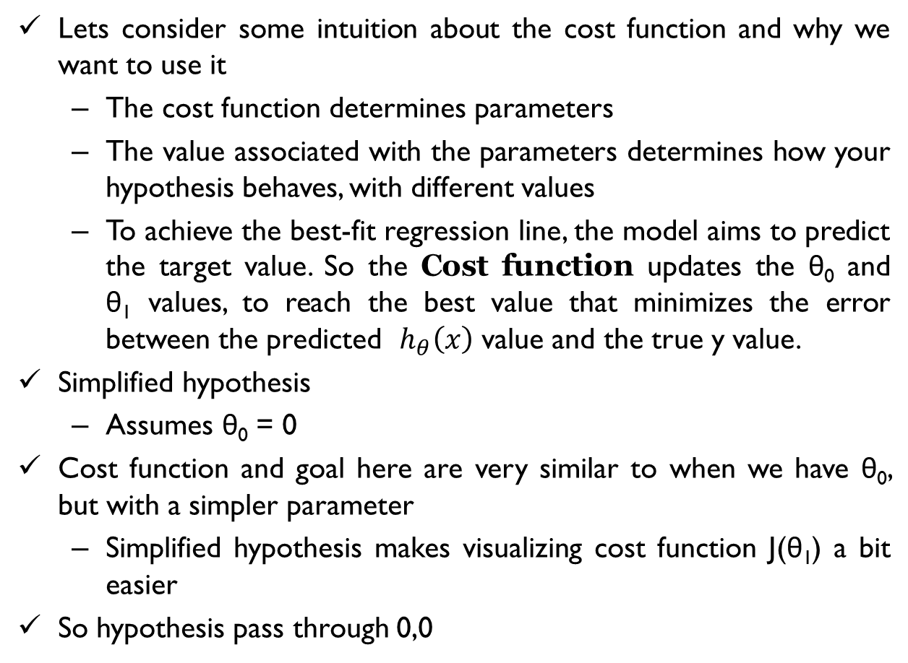
Cost function - a deeper look
Lets consider some intuition about the cost function and why we want to use it
The cost function determines parameters
The value associated with the parameters determines how your hypothesis behaves, with different values
To achieve the best-fit regression line, the model aims to predict the target value. So the Cost function updates the θ₀ and θ₁ values, to reach the best value that minimizes the error between the predicted $h_{θ}\left(x\right)$ value and the true y value.
Simplified hypothesis
Assumes θ₀ = 0
Cost function and goal here are very similar to when we have θ₀, but with a simpler parameter
Simplified hypothesis makes visualizing cost function J(θ₁) a bit easier
So hypothesis pass through 0,0

Slide 25
Cost function - a deeper look (Cont.)
Two key functions we want to understand
h_{θ}(x)
Hypothesis is a function of x - function of what the size of the house is
J(θ₁)
Is a function of the parameter of θ₁
So for example
θ₁ = 1
J(θ₁) = 0
Plot
θ₁ vs J(θ₁)
Data
1)
θ₁ = 1
J(θ₁) = 0
2)
θ₁ = 0.5
J(θ₁) = ~0.58
3)
θ₁ = 0
J(θ₁) = ~2.3

Slide 26
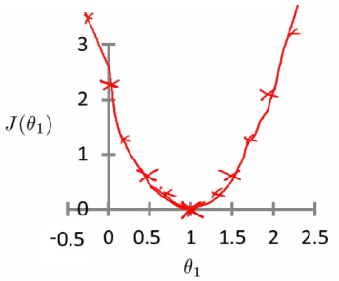
Cost function - a deeper look (Cont.)
If we compute a range of values plot
J(θ₁) vs θ₁ we get a polynomial (looks like a quadratic)
The optimization objective for the learning algorithm is find the value of θ₁ which minimizes J(θ₁)
So, here θ₁ = 1 is the best value for θ₁

Slide 27
Thank You

Slide 28
